Slide 1
Smart City Traffic Prediction using Machine Learning
Student name:

Slide 2
Introduction
In the realm of modern urban development, the concept of Smart Cities has emerged as a transformative force, promising enhanced sustainability, mobility, and quality of life. At the forefront of this urban evolution is the "Smart City Traffic Prediction" project, which seeks to address the critical challenge of managing traffic and congestion within urban environments. Leveraging advanced data analytics and predictive modeling, this initiative aims to create a cutting-edge Smart City Traffic Management System (Dembski et al., 2020). This system is designed to provide real-time traffic updates, congestion alerts, and optimized routes to commuters, offering an innovative solution for urban mobility. In this context, thorough exploratory data analysis (EDA) of the project's dataset reveals valuable insights into the distribution of traffic data across different junctions and paves the way for data-driven decision-making and intelligent urban planning. As the project unfolds, these insights will serve as a foundation for building a more efficient and sustainable urban future.

Slide 3
Motive
The motive behind the Smart City Traffic Prediction project can be summarized in four key points:
Enhancing Urban Mobility: To improve the daily commute experience for residents and visitors by providing real-time traffic information and alternate routes, reducing congestion, and saving time.
Sustainable Urban Development: Promoting eco-friendly urban planning by optimizing traffic flow, which in turn reduces fuel consumption and environmental impact, contributing to a more sustainable future.
Data-Driven Decision-Making: Leveraging advanced technologies and data analytics to empower city authorities and transportation companies with insights for informed decision-making in managing traffic and city resources.
Economic and Social Benefits: Creating safer and more livable cities not only enhances the quality of life for inhabitants but also stimulates economic growth and development through increased efficiency in transportation and urban services.

Slide 4
Methodology
The methodology for the Smart City Traffic Prediction project comprises a multifaceted approach. It begins with comprehensive data collection from various sources, including sensors, traffic cameras, and historical datasets, which is followed by data cleansing, transformation, and integration to ensure accuracy. Subsequently, a predictive analytics engine, employing machine learning algorithms, is utilized to analyze this data and generate real-time traffic updates, congestion alerts, and suggested alternate routes. The user interface component encompasses web-based dashboards and mobile applications for end-users, facilitating access to these insights and enabling user customization for personalized recommendations. The project emphasizes iterative development, rigorous testing, and ongoing optimization to create a robust and effective Smart City Traffic Management System aligned with the objectives of enhancing urban mobility, sustainability, data-driven decision-making, and economic benefits (Dembski et al., 2020).

Slide 5
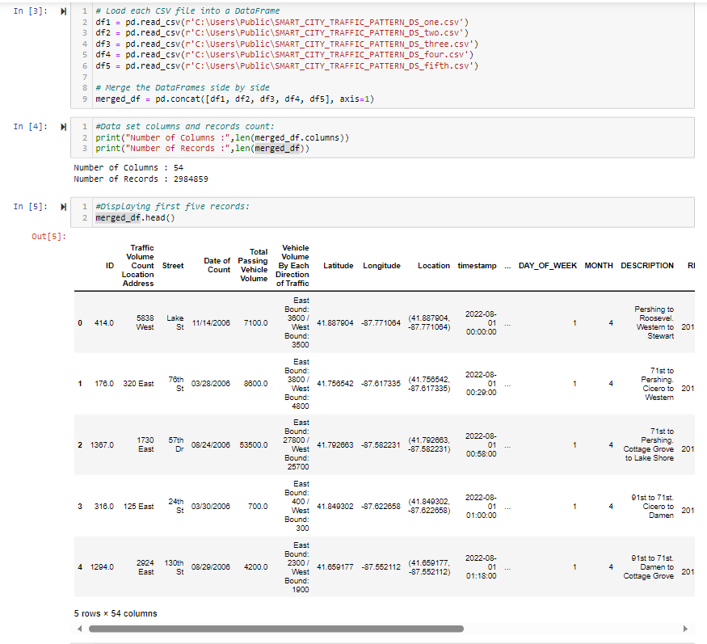
Data Set Information:

Slide 6
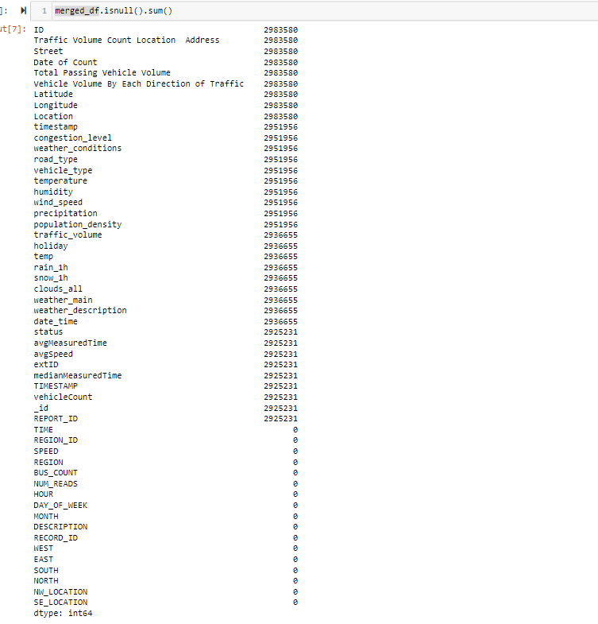
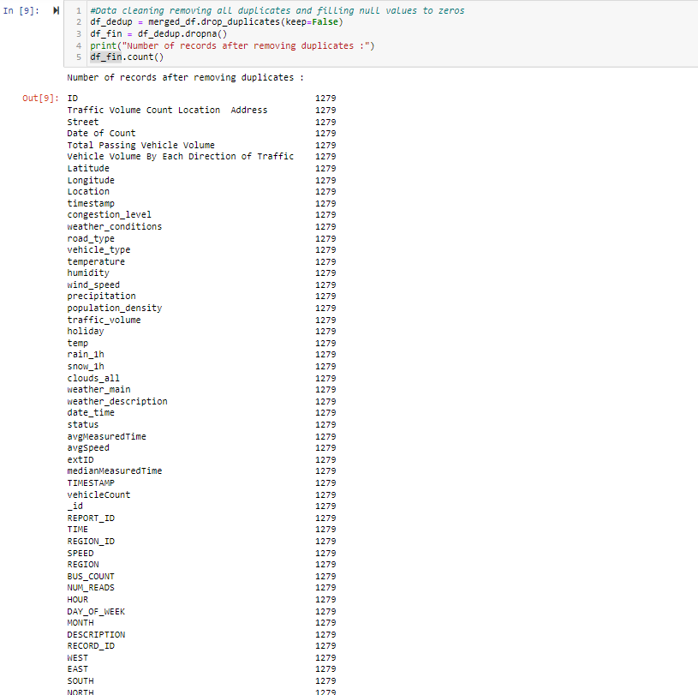
Data Cleaning

Slide 7
EDA Progress
Dataset Description: Detailed explanation of the dataset, including the 'DateTime,' Total Passing Vehicle Volume,' and 'ID' columns, and many more and their respective data types.
Count of Unique Values: Assessment of unique values in each column, indicating that has 2984859 records and has 54 columns.
EDA for weather_conditions: Visualization of data distribution across different weather conditions, demonstrating the balanced distribution of data points.
EDA for road_type: A reaffirming the even distribution of data points among the road type.
EDA for vehicle_type: Presentation of trends and patterns in vehicle type values over time, providing insights into the dataset's temporal dynamics.
EDA for weather_main : Visual summary of central tendency and variability in weather values, indicating consistent data distribution.
EDA for weather_description : Exploratory analysis using count plot to identify potential correlations or patterns.
EDA for MONTH: A graphical representation of the central tendency and variability in month readings, suggesting a consistent data distribution.
EDA for DAY_OF_WEEK: A visual representation of the central tendency and fluctuation in day of week readings, suggesting a consistent data distribution.
EDA for Year: Count plot is used in exploratory analysis to identify potential correlations or trends.

Slide 8
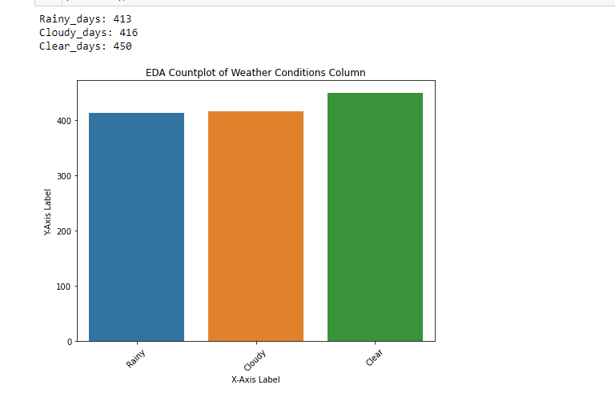
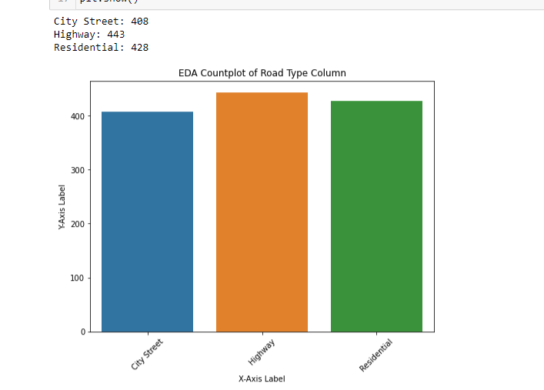
EDA Outcomes

Slide 9
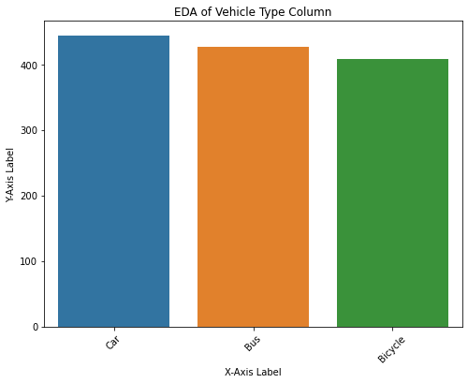
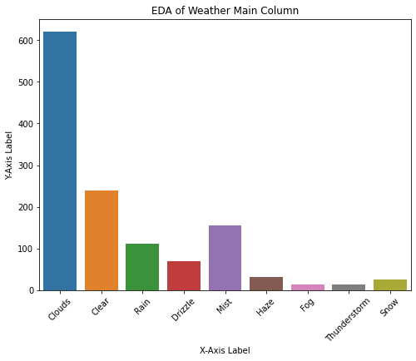
EDA Outcomes

Slide 10
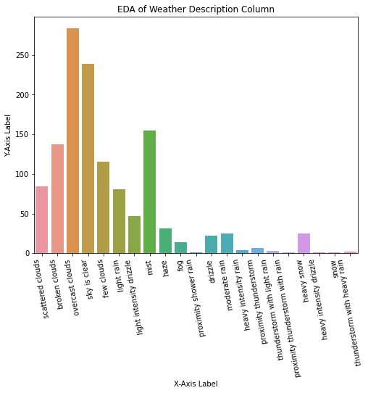
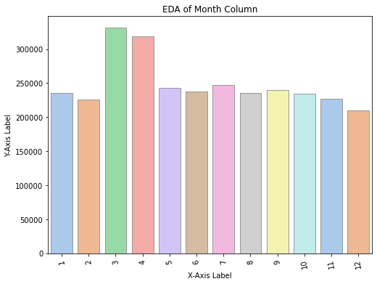
EDA Outcomes

Slide 11
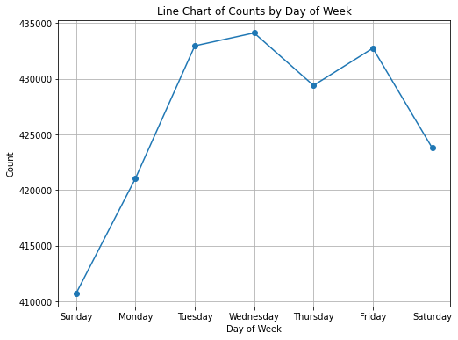
EDA Outcomes

Slide 12
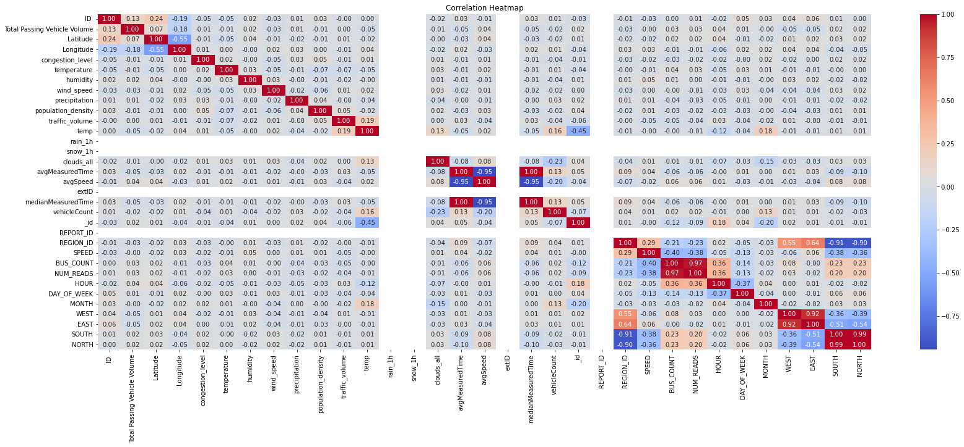
Heatmap of the correlation matrix

Slide 13
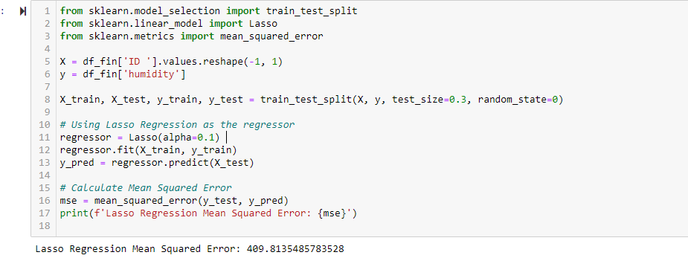
Lasso Regression On Humidity

Slide 14
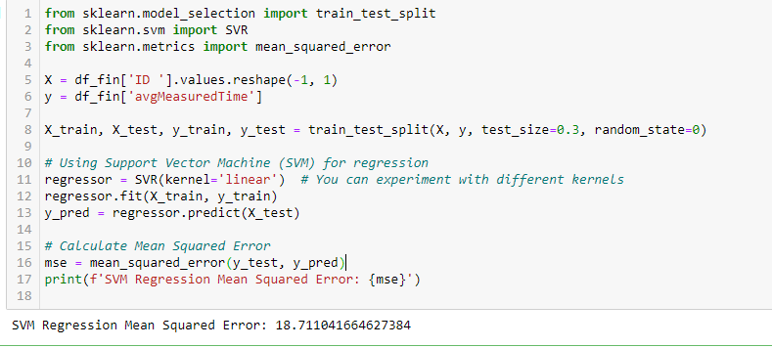
SVM Regression On Avg Measured Time

Slide 15
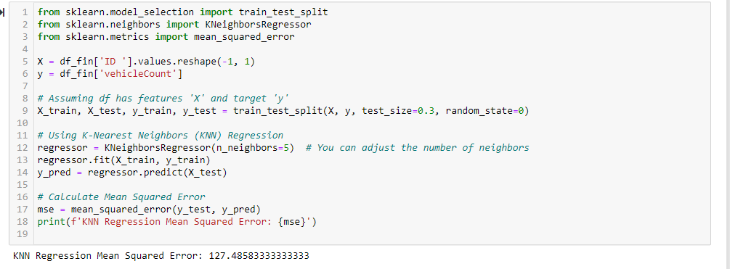
KNN Regression On Vehicle Count

Slide 16
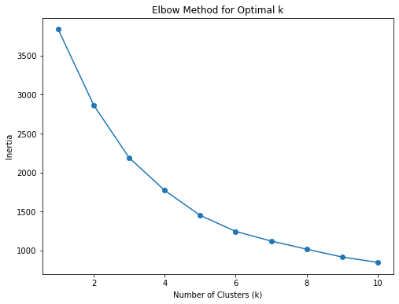
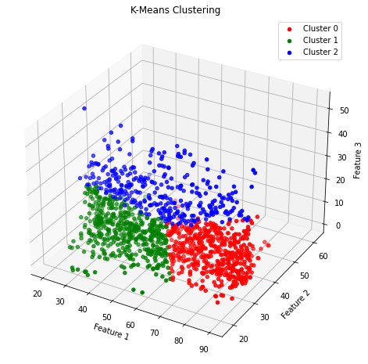
Clustering on humidity, avgMeasuredTime and vehicleCount

Slide 17
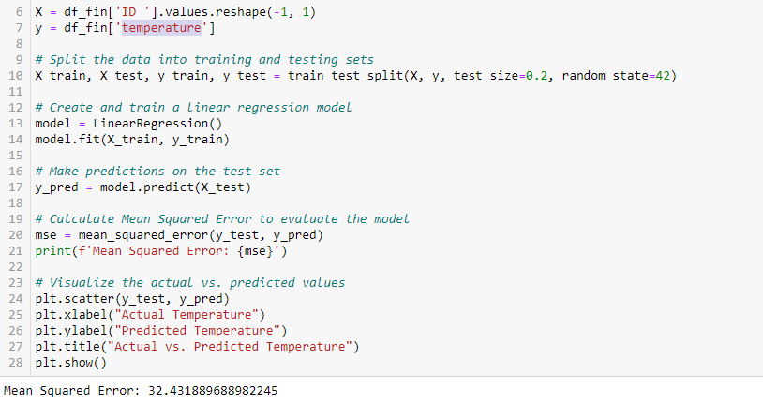
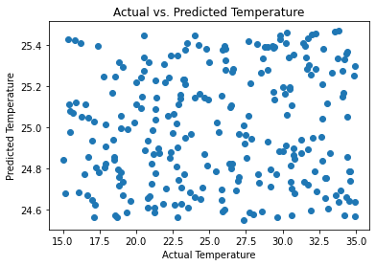
Linear regression model on temperature

Slide 18
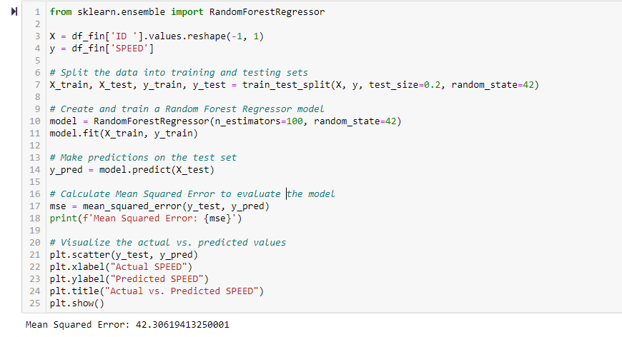
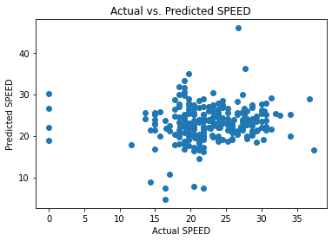
Random Forest Regressor model On Speed

Slide 19
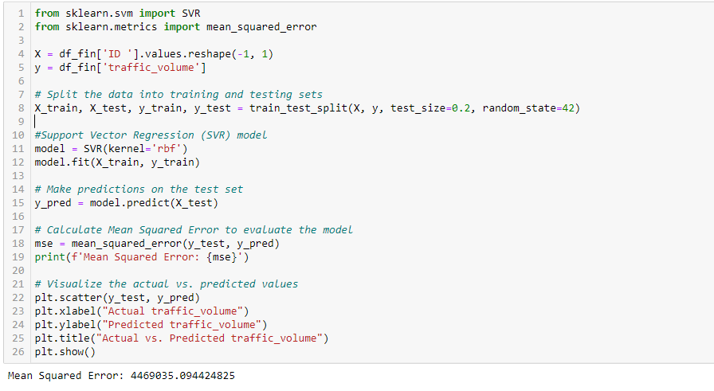
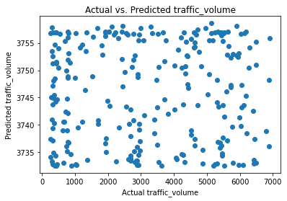
Support Vector Regression Model On Traffic Volume

Slide 20
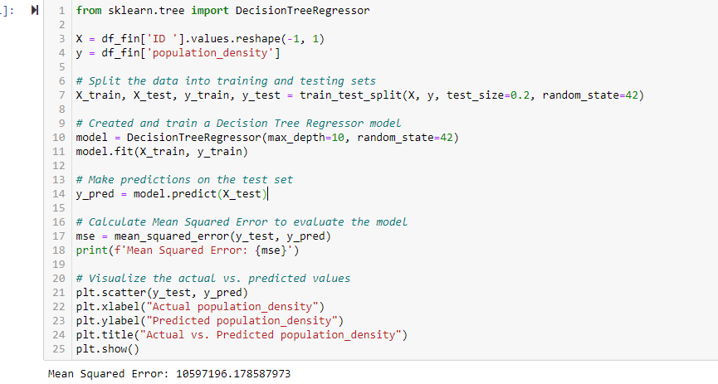
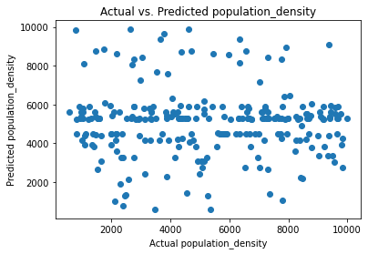
Decision Tree Regressor model on population density

Slide 21
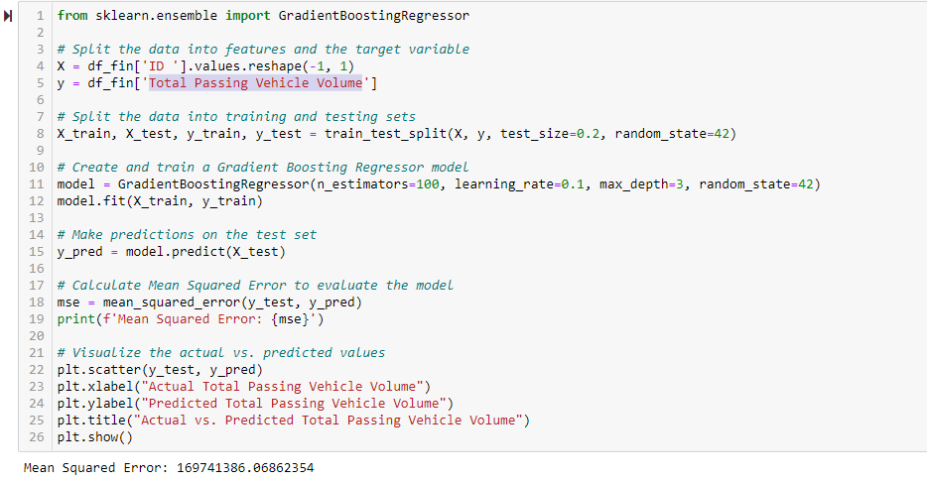
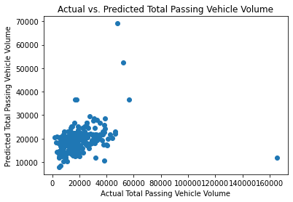
Gradient Boosting Regressor model On Total Passing Vehicle Volume

Slide 22
Reference
Kothai, G., Poovammal, E., Dhiman, G., Ramana, K., Sharma, A., AlZain, M. A., ... & Masud, M. (2021). A new hybrid deep learning algorithm for prediction of wide traffic congestion in smart cities. Wireless Communications and Mobile Computing, 2021, 1-13.
https://www.hindawi.com/journals/wcmc/2021/5583874/
Zhang, F., Wu, T. Y., Wang, Y., Xiong, R., Ding, G., Mei, P., & Liu, L. (2020). Application of quantum genetic optimization of LVQ neural network in smart city traffic network prediction. IEEE Access, 8, 104555-104564.
https://ieeexplore.ieee.org/abstract/document/9107118/
Dembski, F., Wössner, U., Letzgus, M., Ruddat, M., & Yamu, C. (2020). Urban digital twins for smart cities and citizens: The case study of Herrenberg, Germany. Sustainability, 12(6), 2307.
https://www.mdpi.com/2071-1050/12/6/2307

Slide 23
Thank You

